Slide 1


Presented By
S.M Mahamudul Hasan
2016331032
Nirjas Mohammad Jakilim
2016331101
Fake News Detection
in Bangla Language Using
Machine Learning Algorithms
Supervisor
Enamul Hassan
Assistant Professor
Department of
Computer Science & Engineering

Slide 2
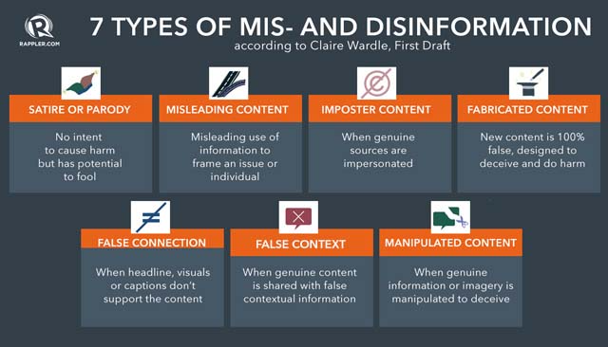
WHAT IS FAKE NEWS?
Fake news is false or misleading information presented as news. (Wikipedia)
2

Slide 3


70%
Internet Users
90%
of them consumes news from Internet
“Any new article must go through
A Test on the Truthfulness of Content
before being published”

Slide 4

1K+
News Portals
100K+
Daily Published News

Slide 5
WHY FAKE NEWS DETECTION?
Rapid spread of fake news should be stopped.
An automated system is needed. Because,
Human checking is too inefficient and time consuming.
Available websites (jaachai.com, bdfactcheck.org, fact-watch.org) also use human efforts.
3

Slide 6
EXISTING METHODS
Knowledge Based Methods.
Style-based Methods.
Propagation-based methods.
Source-based methods.
4

Slide 7
Previous research about fake news in Bangla Language
Arnab et el. proposed a CNN Approach Based on Hybrid Feature Extraction Model to detect satire documents.
Zobaer et el. proposed a dataset to detect fake news in bangla language.
Gulzar et el. Proposed polarity based detection approach using SVM and MNB.
4

Slide 8
PREVIOUS Contribution
OUR contribution
Extended the fake news dataset.
Analyzed and explored the extended dataset.
Clean and Preprocess the extended dataset.
Evaluated machine learning models on the dataset.
Proposed and annotated a dataset to detect bangla fake news.
Provided an analysis of the dataset using linguistic features.
4

Slide 9
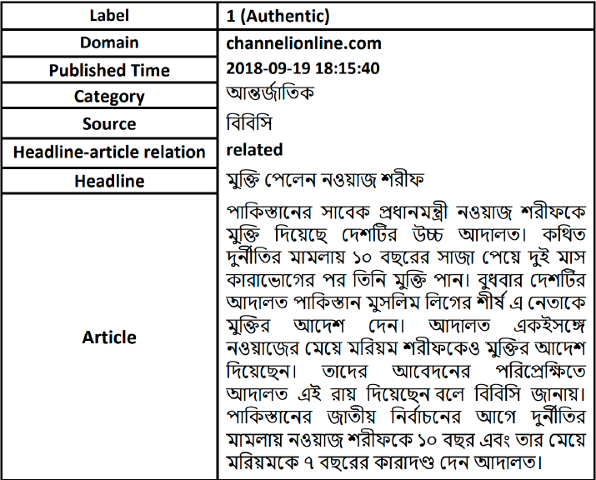
DATA COLLECTION
Dataset Features
Dataset collected from Kaggle.
Added our extended 130 fake news data with the kaggle dataset.
7

Slide 10



Dataset
50057
48628
1429
Total
True
Fake
 | Total | Characters | Punctuations | Words | Sentence
Authentic | 48628 | 1482.87 | 41.30 | 271.99 | 21.21
Fake | 1429 | 1560.12 | 43.69 | 278.42 | 23.82

Slide 11
Methodologies
Traditional Models
SVM
PAC
3
Adaboost
1
2
4
MNB
5
LR
6
Random Forest
Experiment Setup
 | Authentic | Fake
Train | 34040 | 1000
Test | 14588 | 428

Slide 12
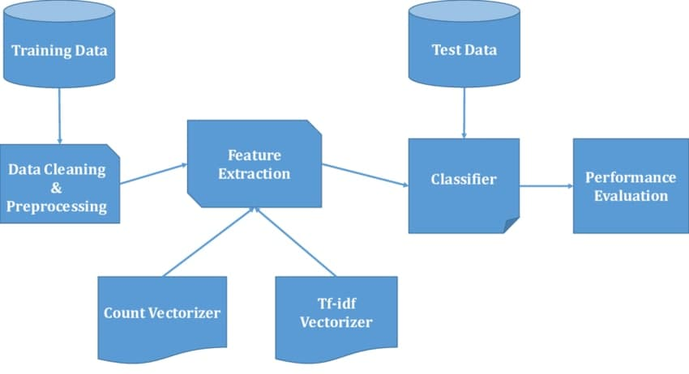
DIAGRAM OF OUR OVERALL APPROACH
8

Slide 13
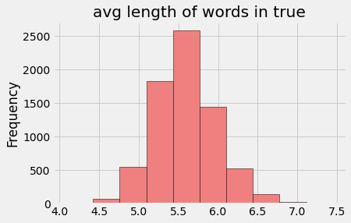
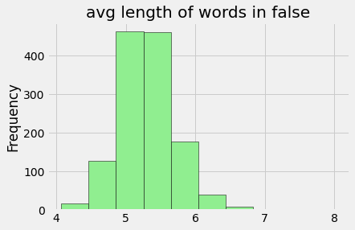
Average Word Length in True and Fake
True news have more dynamic word length than fake news.
8

Slide 14
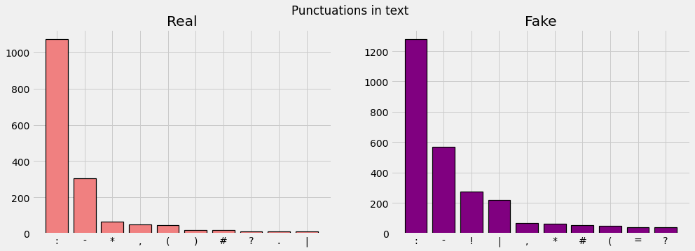
Punctuation mark count in real and fake news
8

Slide 15
PREPROCESSING
Stopword removal -
Removing the common words like এ, এবং, আর, etc.
Cleaning invalid characters and punctuation marks.
POS Tagging -
Annotating words with parts-of-speech tags.
Lemmatizing -
Grouping the same forms of words together.
8

Slide 16
EXPERIMENTS
Key Informations
Headline and Body text are the features.
TF-IDF and CountVectorizer are the word-embedding techniques. TfidfVectorizer and CountVectorizer of sklearn is used.
70% of the dataset for training and 30% for primary evaluation.
SVM, Logistic Regression, Passive Aggressive Classifier, MNB, Random Forests, and AdaBoost are implemented for initial evaluation.
9

Slide 17
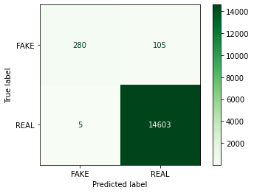

Support Vector Machines
Tuned the C Parameter of Support vector machine
Got the highest accuracy of 99.28% at c=10
Using TF-IDF
Using CountVectorizer
10

Slide 18
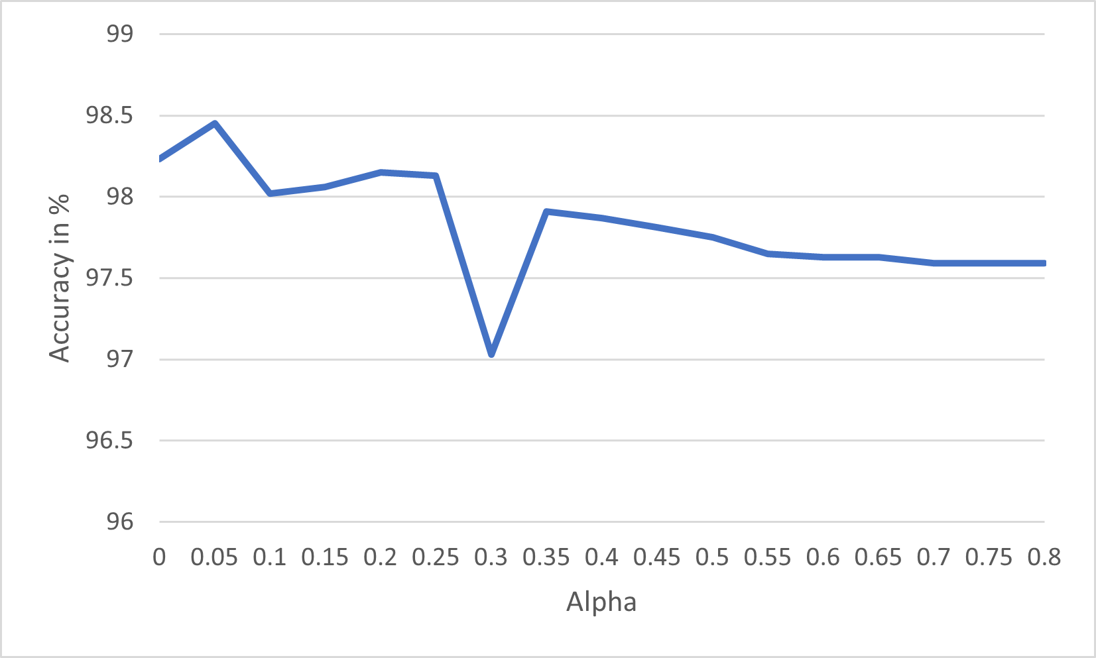


Multonomial Naive Bias
Tuned the alpha parameter of MNB from 0 to .8
Got the highest accuracy 98.54 using alpha = 0.1
Detected highest amount of True Fake News.
Using TF-IDF
Using CountVectorizer
Tuning graph of MNB
10

Slide 19
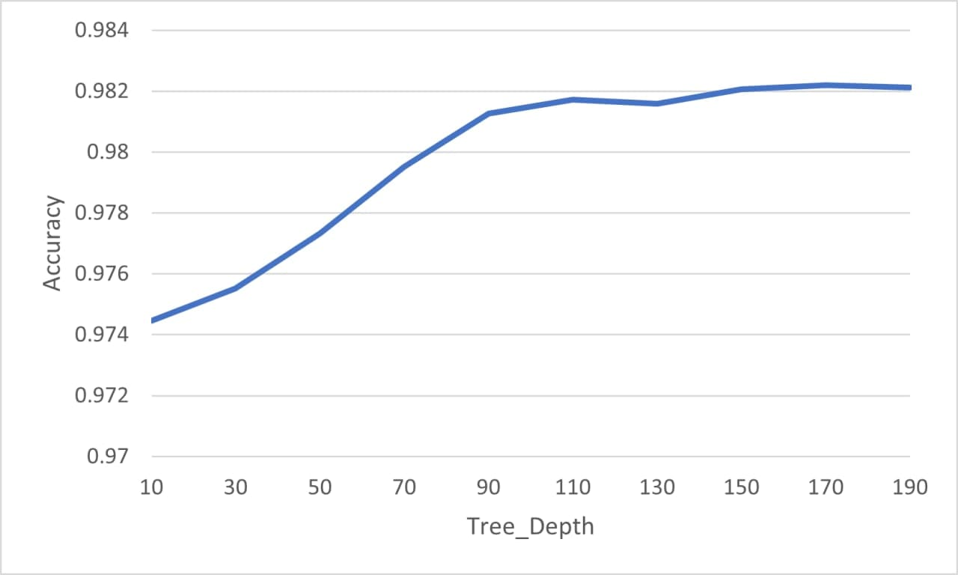
Random Forests
Used entropy as criterion
Tweaked using different depth of trees.
Got highest accuracy of 98.21 for max_depth=190
Tuning graph of Random Forests
10

Slide 20
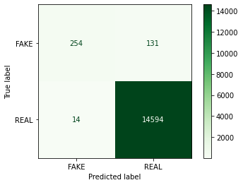
Logistic Regression
Observed LR for both TF-IDF and Countvectorizer.
Got the best result for CountVectorizer.
Accuracy for TF-IDF: 97.9%
Accuracy for Countvectorizer: 99.03%
Using CountVectorizer
10

Slide 21

Passive Aggressive Classifier
Tuned the PAC and got the highest result for max_iter=10
Accuracy for TF-IDF: 99.33%
Got the 2nd highest number of True Negatives.
Confusion Matrix using TF-IDF
10

Slide 22


AdaBoost Classifier
Evaluated using preset parameters.
Got accuracy of 98.31% for TF-IDF
TF-IDF
CountVectorizer
10

Slide 23
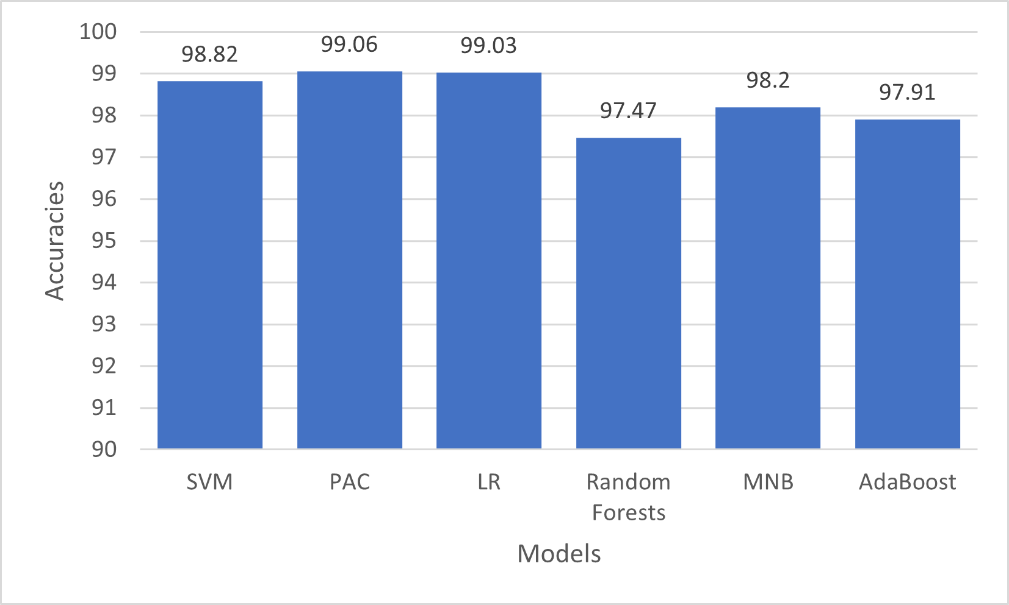
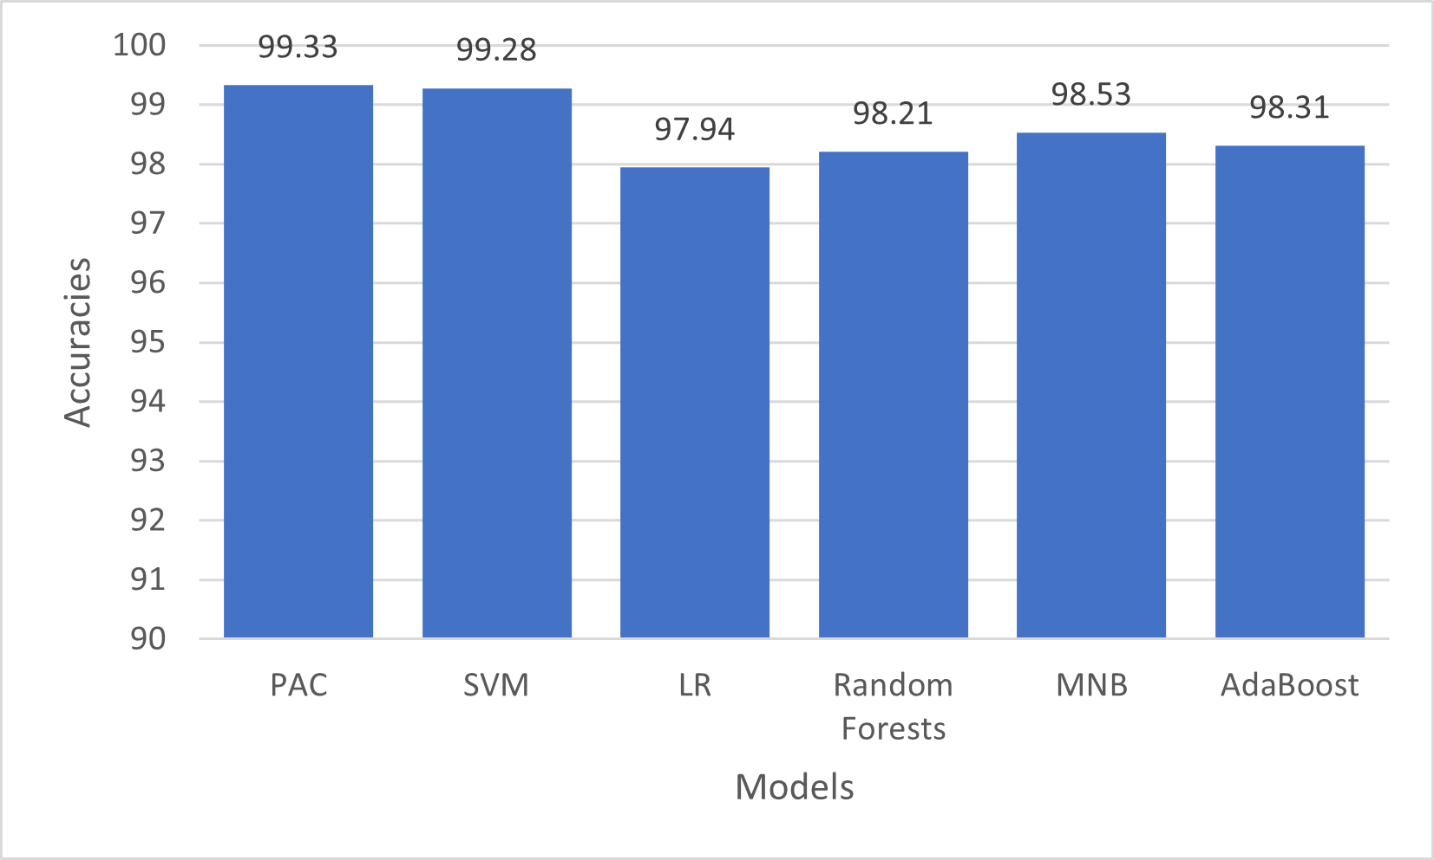
Results for CountVectorizer
Results for TF-IDF
Fig : Different accuracy rates against different classifiers
13

Slide 24
EXPERIMENTS (Cont.)
Critical Case
Fails to analyze semantic meaning
TF-IDF and Countvectorizer only depends on word frequency and can’t identify any semantic meaning between words.
Possible Solution
A better word embedding approach like bangla word2vec and doc2vec model.
14

Slide 25
PROPOSED METHOD
Use bangla word2vec and doc2vec model for feature extraction.
Implement better neural network models like CNN, LSTM, BiLSTM, RNN, Bangla-Bert and evaluate their performances.
23

Slide 26
FUTURE WORKS
Implementation of the proposed method
Improvement of the proposed method
And finally, Introduction of a better hybrid model which works best for bengali fake news.
32

Slide 27
Thank You

Slide 28
Questions and Suggestions ?

